Slide 1

CSS Architecture – ITCSS
Inverted Triangle CSS
SoftUni Team
Technical Trainers
Software University
https://softuni.org

Slide 2
Table of Contents
Challenges for CSS
What is ITCSS?
ITCSS Layers
Settings
Tools
Generic
Elements
Components
Objects
Utilities
Notes:
2

Slide 3
Have a Question?
sli.do
#front-end
Notes:
3

Slide 4
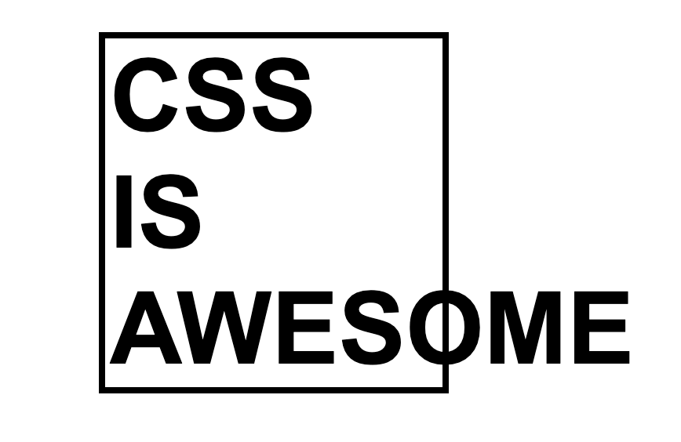
Most Common CSS and Developers Problems
Notes:
4

Slide 5
Problems That Come from CSS
Cascade and Inheritance
Touch something at one place breaks it in all other places (because CSS is global)
Source order
Moving CSS around can have unwanted impact
Specificity
Selectors are way too specific

Slide 6
Problems That Come from Developers
No structure & No layers
Designers, Back-End Developers, all touch CSS
Lack of knowledge
Adding styles to the end of a stylesheet
Usually write more CSS to undo previous CSS styles

Slide 7
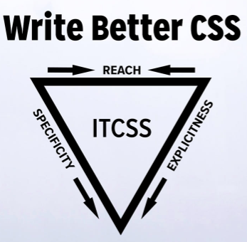
Inverted Triangle CSS
Notes:
7

Slide 8
What is ITCSS?
Inverted Triangle architecture for CSS
A sane, scalable, managed architecture
A meta framework
It can be used with preprocessors or without them
It's compatible with CSS methodologies like BEM, SMACSS or OOCSS

Slide 9
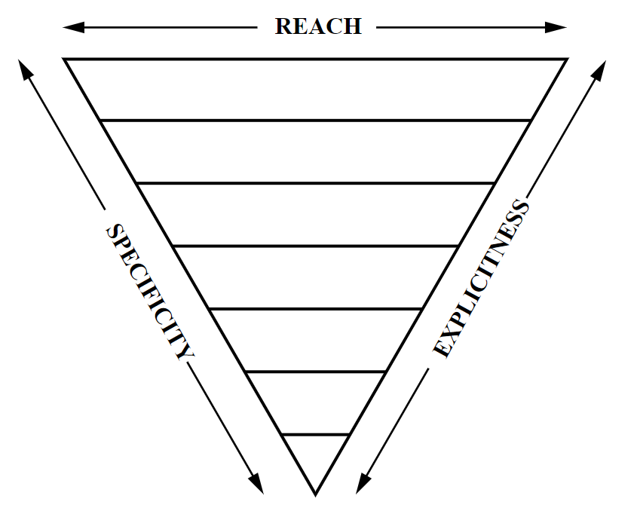
What is ITCSS?
How styles represented by selectors are ordered in the resulting CSS
From generic styles to explicit ones
From low-specificity selectors to more specific ones (but still not too specific, IDs are not allowed)
From far reaching to localized ones

Slide 10
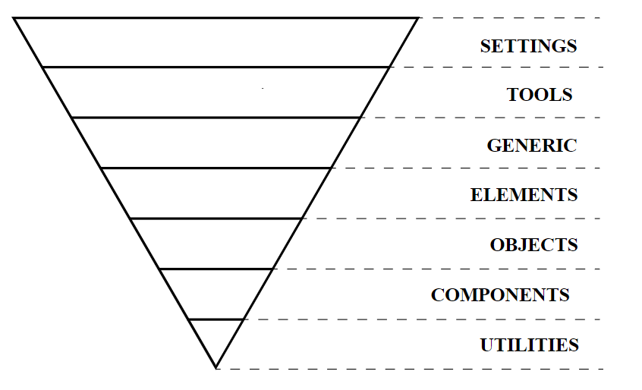
Inverted Triangle CSS
Notes:
10

Slide 11
ITCSS Layers
It separates your CSS codebase to several sections (called layers), which take the form of the inverted triangle:

Slide 12

ITCSS Layers – Settings
Settings - used with preprocessors and contain font, colors definitions, etc.
Tools - globally used mixins and functions
It's important not to output any CSS in the first 2 layers

Slide 13
ITCSS Layers – Generic
Generic - reset and/or normalize styles, box-sizing definition, etc.
This is the first layer which generates actual CSS
html {
box-sizing: border-box;
height: 100%;
}
*, *:before, *:after {
box-sizing: inherit;
}

Slide 14
ITCSS Layers – Elements
Elements - styling for bare HTML elements (like h1, a, etc.)
Come with default styling from the browser so we can redefine them
a {
font-size: 16px;
font-family: 'Lato', sans-serif;
font-weight: 500;
text-decoration: none;
}
a:hover {
text-decoration: underline;
}

Slide 15
ITCSS Layers – Components
Components - specific UI components
This is where most of the work takes place
.card-wrapper {
cursor: pointer;
border-radius: 8px;
}
.card-wrapper:hover {
text-decoration: none;
}

Slide 16
ITCSS Layers
Objects - class-based selectors which define undecorated design patterns
Utilities - utilities and helper classes with ability to override anything which goes before in the triangle, e.g. hide helper class

Slide 17


Practical Exercises
Notes:
17

Slide 18

About Page
Create the following page using the ITCSS architecture:

Slide 19

About Page
Use the given resources
Don't forget to follow the best practices

Slide 20

Summary
What is ITCSS
ITCSS Layers
Settings
Tools
Generic
Elements
Components
Objects
Utilities
Notes:
20

Slide 21
Questions?
Notes:
21

Slide 22














SoftUni Diamond Partners

Slide 23

License
This course (slides, examples, demos, exercises, homework, documents, videos and other assets) is copyrighted content
Unauthorized copy, reproduction or use is illegal
© SoftUni – https://softuni.org
© Software University – https://softuni.bg
Notes:
23

Slide 24
Trainings @ Software University (SoftUni)
Software University – High-Quality Education, Profession and Job for Software Developers
softuni.bg
Software University Foundation
softuni.foundation
Software University @ Facebook
facebook.com/SoftwareUniversity
Software University Forums
forum.softuni.bg
Notes:
24

